Slide 1
Coding Contest Prep

Slide 2
Thanks for being here

Slide 3
Agenda
Coding Contest Format, Rules, Judging, What you can expect
Basic tips for being good at contests
Review ten basic problems in detail
Look at structure, attacks
Pick some problems and have practice coding exercises for time. Use an online judge.

Slide 4
What I know now
5 hours
Single computer – theirs
No notes, thumb drives, ect.
No internet
I have last contests problems, but no answers
They will use a combination of on line judge and manual judging
Problems will be easier than last contest.
Works to our advantage

Slide 5
What does this mean
We need team strategy make sure we have strengths understood and organize accordingly.
We need to know coding – basics but also the most direct C++ 11, STL empowered attack.
Need to have game plan and no what do if problems come up.

Slide 6
Being Good at Contests and coding in general
Learn how to type – faster the better
Be able to quickly identify problem types
Do algorithm analysis based on problem parameters
Master a programming language – For us its c++ now. This can evolve.
Master code testing – identifying test cases

Slide 7
Typing fast
I am the wrong guy to help you there.
On line resources.

Slide 8
Problem Types
Ad Hoc
Complete Search
Divide and Conquer
Greedy
Dynamic Programming
Graph
Mathematics, discrete math
String Processing
Computational Geometry
Hard/Rare problems

Slide 9
Algorithm Analysis
Try to understand how good your algorithm needs to be.
Think about input set size
Look at time to compute versus any time limits

Slide 10
Master Language
That’s what we are trying to do
Use STL
Use C++ 11
Use C
Fundamentals
I/O is super important

Slide 11
Master Test Cases
Edges
Don’t just assume limits are anywhere like examples
If it doesn’t say it can’t be it can be!!!!

Slide 12
My Strategy
Can’t do everything in a few hours so lets try to focus on a few things, be exposed to more, recognize we need look a even more. Understand better what we don’t know.
Competition is all about cycles of learning
All about starts

Slide 13
Any Questions So Far??

Slide 14
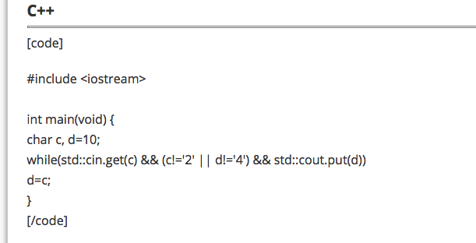
Lets get started I/O
codechef
WTF?

Slide 15
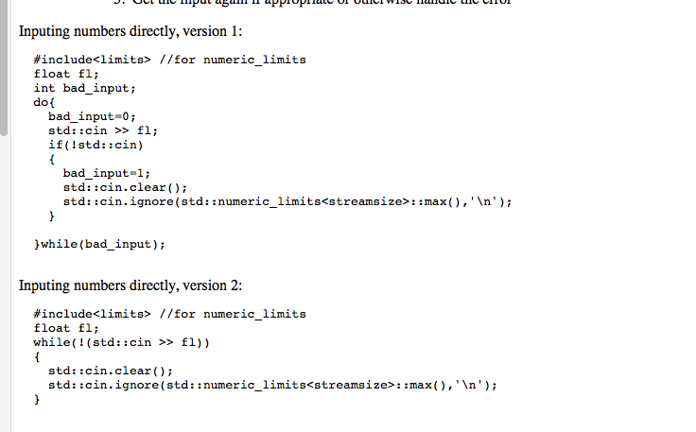
Lets get started I/O
http://www.augustcouncil.com/~tgibson/tutorial/iotips.html

Slide 16
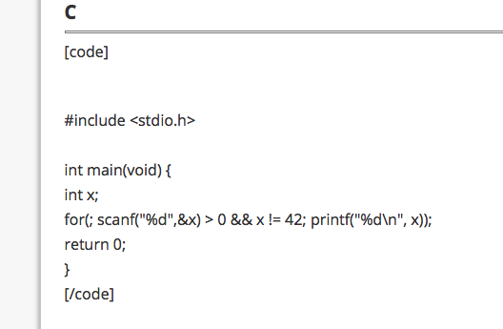
Lets get started

Slide 17
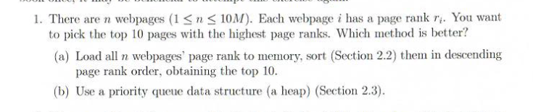
Lets get started

Slide 18
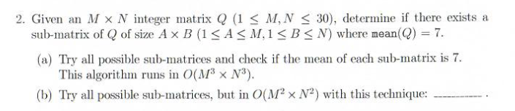
Lets get started

Slide 19
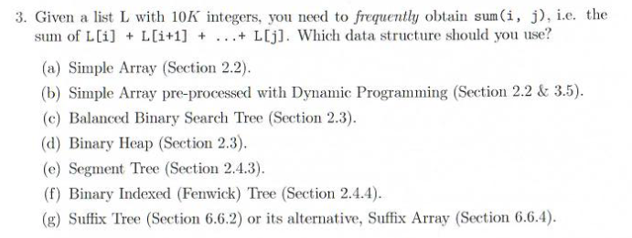
Lets get started

Slide 20
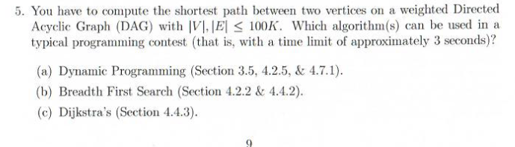
Lets get started

Slide 21
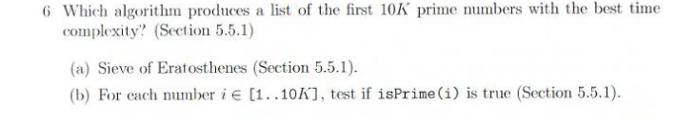
Lets get started

Slide 22
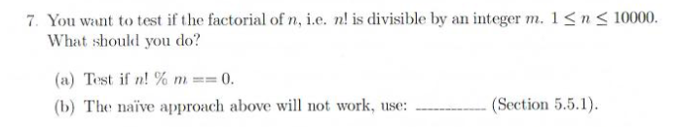
Lets get started

Slide 23
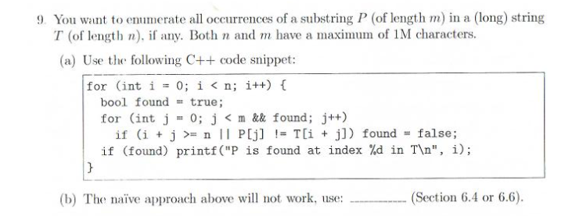
Lets get started

Slide 24
Summary
You know a lot

Slide 25
Summary
You know a lot
Lots to know!

Slide 26
Basic Problems
What can we learn?
LOTS

Slide 27
Problem 1
1. Given an integer n <=15, print n digits after the decimal point. eg. for n= 4 print 3.1416
1. Understand limits
2. Any speed concerns?
3. Algorithm ?

Slide 28
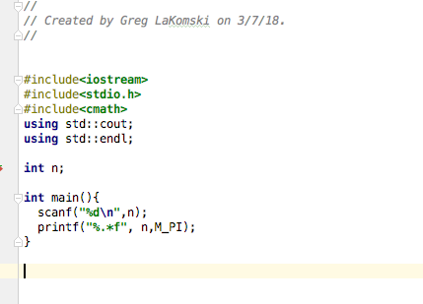
Problem 1
1. Given an integer n <=15, print n digits after the decimal point. eg. for n= 4 print 3.1416

Slide 29
Problem 2
2. Given a date, determine the day of the week (monday - sunday ) on that date.
e.g. 9 August 2010

Slide 30
Problem 2
#include<iostream> #include<cmath> #include<cstdio> #include<string> #include<vector> #include<sstream> #include<cctype> #include<algorithm> using std::cout; using std::endl; using std::vector; //using namespace std; typedef unsigned long ul; //typedef unsigned int ui; stupid // ---------------------------------------------------------------------- // Given the year, month and day, return the day number. // (see: https://alcor.concordia.ca/~gpkatch/gdate-method.html) // ---------------------------------------------------------------------- ul CalcDayNumFromDate(uint y, uint m, uint d) { m = (m + 9) % 12; y -= m / 10; ul dn = 365*y + y/4 - y/100 + y/400 + (m*306 + 5)/10 + (d - 1); return dn; } // ---------------------------------------------------------------------- // Given year, month, day, return the day of week (string). // ---------------------------------------------------------------------- std::string CalcDayOfWeek(int y, ul m, ul d) { std::string day[] = { "Wednesday", "Thursday", "Friday", "Saturday", "Sunday", "Monday", "Tuesday" };
ul dn = CalcDayNumFromDate(y, m, d);
return day[dn % 7];
}
std::vector<std::string> split(const std::string &str, char delim = ' ') {
std::stringstream ss(str);
std::string item;
std::vector<std::string> tokens;
while (std::getline(ss, item, delim)) {
tokens.push_back(std::move(item));
}
return tokens;
}
int main() {
std::string date;
std::getline(std::cin, date); // inputs line
std::transform(date.begin(), date.end(),date.begin(),::tolower); // takes line to lower case
auto tokens = split(date); // tokenizes using split function, can set different delimiters
int day = stoi(tokens[0]);
std::string month = (tokens[1]);
int year = std::stoi(tokens[2]);
");

Slide 31
Problem 2
if (month == "january") { intmonth =1;}
else if (month == "february") { intmonth =2;}
else if (month == "march"){ intmonth =3;}
else if (month == "mpril"){ intmonth =4;}
else if (month == "may"){ intmonth =5;}
else if (month == "june"){ intmonth =6;}
else if (month == "july"){ intmonth =7;}
else if (month == "august"){ intmonth =8;}
else if (month == "september"){ intmonth =9;}
else if (month == "october"){ intmonth =10;}
else if (month == "november"){ intmonth =11;}
else if (month == "december"){ intmonth =12;}
else (throw " can't recognize month");
//ui y = 2017, m = 8, d = 29; // 29th August, 2017.
std::string dow = CalcDayOfWeek(year, intmonth, day);
printf("%02d\/%02d\/%d\n",day,intmonth,year);
std::cout <<dow << std::endl;
return 0;
}

Slide 32
Problem 3
3. Given n random integers, print the distinct (unique) integers in sorted order

Slide 33
Problem 3
// // Created by Greg LaKomski on 3/10/18. // #include<cstdlib> #include<iostream> #include<cmath> #include<cstdio> #include<string> #include<vector> #include<sstream> #include<cctype> #include<algorithm> #include<vector> #include<list> #include<time.h> using std::cout; using std::endl; int main() { srand(time(NULL)); std::list<int> aList(1000000); // auto b = 0; // std::cin >> b; //while (std::cin){ // aList.push_back(b); // std::cin >> b
auto start = std::chrono::high_resolution_clock::now(); // generates ints that are 3 digits std::generate(aList.begin(), aList.end(), [] () {return std::rand()/ 10000000;}); aList.sort(); aList.unique(); auto finish = std::chrono::high_resolution_clock::now(); std::chrono::duration<double> elapsed = finish - start; cout << endl << "Elapsed time: " << elapsed.count() << "s\n"; // prints out list size cout << aList.size()<< endl; // prints out the list for(auto& x : aList ){ cout << x << endl;}

Slide 34
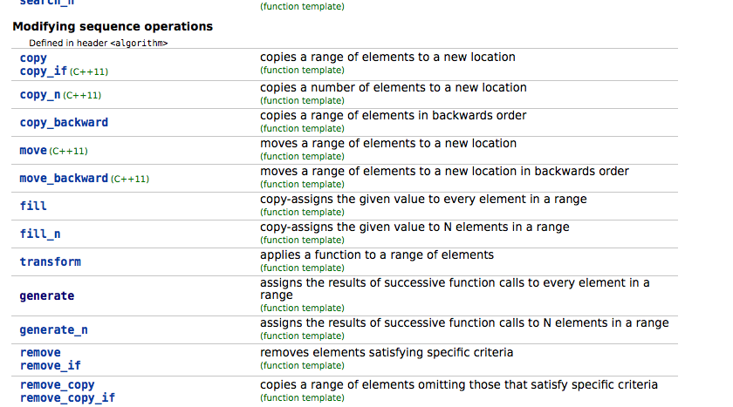
<algorithm>

Slide 35
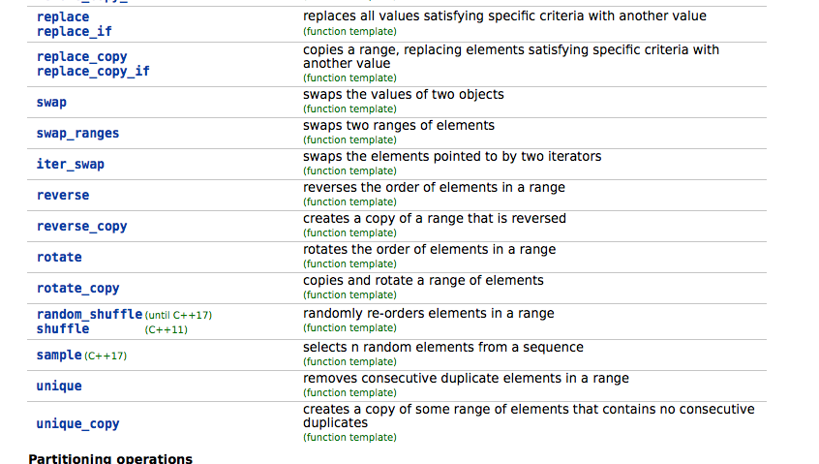
<algorithm>

Slide 36
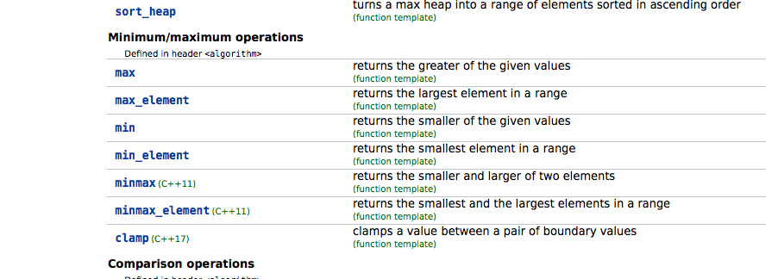
<algorithm>

Slide 37
Problem 4
4. Given the distinct and valid birthdates of n people as triples(DD,MM,YYYY), order them first by ascending birth months (MM), then by ascending birth dates(DD), then finally by ascending year.

Slide 38
Problem 4

Slide 39
Problem 5
5. Given a list of sorted integers L of size up to 1 Million items, determine whether a value exists in L with no more than 20 comparisons.

Slide 40
Problem 5

Slide 41
Problem 6
6. Generate all possible permutations of the first ten CAPITAL letters of the alphabet
sorted: 13.6933s
unsorted: 14.1355s

Slide 42
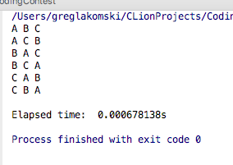
Problem 6
//
// Created by Greg LaKomski on 3/12/18.
//
#include<iostream>
#include<cmath>
#include<stdio.h>
#include<vector>
#include<algorithm>
#include<string>
#include<time.h>
using std::cout;
using std::endl;
int main() {
//create vector of strings
auto start = std::chrono::high_resolution_clock::now();
//std::vector<std::string> a {"A","B","C","D","E","F","G","H","I","J"} ;
std::vector<std::string> a {"A","B","C"} ;
std::sort(a.begin(),a.end());
do {
std::copy(a.begin(), a.end(), std::ostream_iterator<std::string>(std::cout, " ")); // very cool
std::cout << std::endl;
} while (std::next_permutation(a.begin(), a.end()));
auto finish = std::chrono::high_resolution_clock::now();
std::chrono::duration<double> elapsed = finish - start;
cout << endl << "Elapsed time: " << elapsed.count() << "s\n";
return 0;
}

Slide 43
Problem 7
Generate all possible subsets of {0,1,2,.......,N-1} for N = 20

Slide 44
Problem 7

Slide 45
Problem 8
8. Given a string that represents a base X number (radix X) convert it to an equivalent string in base Y, 2 <+ Y<=36. For example, "FF" in base X=16 is "255" in base Y1 = 10

Slide 46
Problem 8

Slide 47
Problem 9
Lets define a 'special word' as a lower case alphabet followed by two consecutive digits. Given a string, replace all special words of length 3 with 3 stars ***, eg. S = "line: a70 and z72 will be replaced, aa24 and a872 will not" becomes "line: *** and *** will be replaced, aa24 and a872 will not"

Slide 48
Problem 9

Slide 49
Using a Judge
Register at https://uva.onlinejudge.org
Browse problems
example:
Root :: Competitive Programming 3: The New Lower Bound of Programming Contests (Steven & Felix Halim) :: Data Structures and Libraries :: Linear Data Structures with Built-in Libraries :: C++ STL algorithm (Java Collections)::Birthdates

